Slide 2
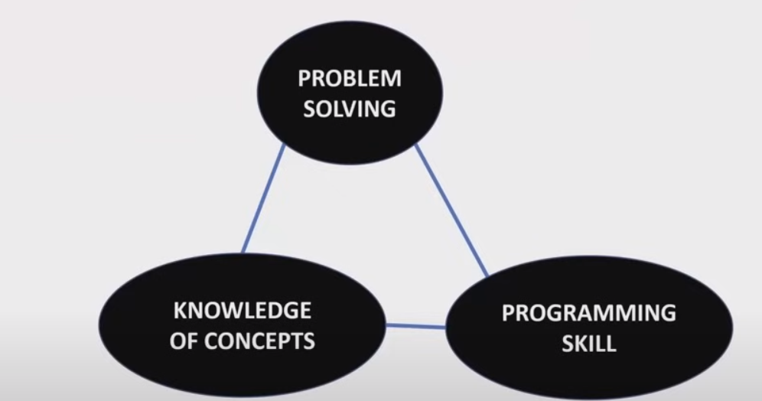
Basics
How will you relate the following three terms?
Propose one real time example to connect three terms.
Add the term in Algorithm Complexity.
Example Qn
Algorithm Complexity
Execution time vs Complexity(time,space)
Find a square root of
number without using built-in fn.?
https://www.geeksforgeeks.org/square-root-of-a-number-without-using-sqrt-function/
Programming skill –
Declarative Knowledge – Statements of Fact
imperative Knowledge – How to do
--------Computer will only do what you will instruct it do – any number of times and any number of machines without tiredness---------
(in different situations(or dataset)
--- Learning Prog. Lang helps you to build syntactically correct statement but practice makes you to solve the problem efficiently--
What Student can do
What Teacher can do

Slide 3
Anaconda
Shell
Programming Environment – Anaconda, a distribution package For python and R
Do I need Anaconda for Jupyter? There are different ways to install Python and Jupyter on your computer. But especially for new users, it is highly recommended to opt for Anaconda. It will install, not only Python but also the Jupyter Notebook App and many scientific computing and data science packages.

